Slide 1
Lecture #7: the National Interest and Decision Making
April 6, 2017

Slide 2
Midterm next Tuesday
In-class
Mix of short answers, multiple choice, some term ID’s, short essay
Review guide and all lecture powerpoints up tonight
Documentaries – Commanding Heights, “Pray the Devil Back to Hell”
4/11
Don’t need a blue book, do need a pen

Slide 3
Limits on traditional IR thinking
There is such a thing as a “national interest”
States are rational

Slide 4
What is the national interest?
Who defines the national interest?
Why is that definition chosen over others?
Realists assume there is a single set of interests and policy makers recognize and pursue them.
Is the “national interest” a myth, and there is rather a variety of special interests that drive policy?

Slide 5
What kinds of interest groups?
What do interest groups want from policy?
They care about trade and war
Typical economic policy argues that trade is mutually beneficial, overall.
  But there are winners and losers
    Steel industry vs. agriculture
    California vs. Industrial Midwest
    Labor unions vs. “big business”
  Fair trade vs. free trade

Slide 6
What do interest groups want?
Military budgets are huge
  “military-industrial complex”
Contractors, business, military employees want big budget
NGOs have projects, policies, and interests that they care about.
  Foreign aid, disease prevention and public health, famine relief, human rights, democratization

Slide 7
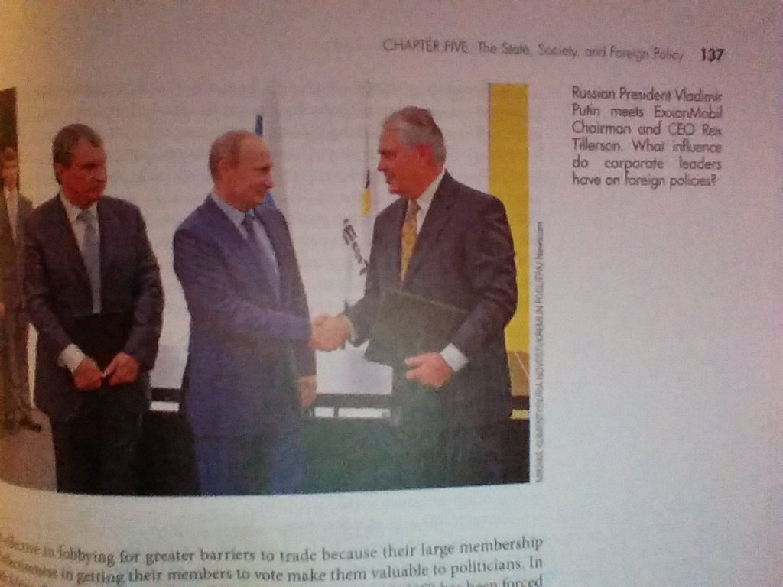
How do interest groups influence policy?
Money
advertising
donations
Expertise
Lobbying
Votes
Jobs after life in politics

Slide 8
How to resist “interest group” driven policy?
International organizations like the WTO and the EU can help
  WTO forces countries towards consistent trade practices
  EU forces countries towards common regulations and policy
    A number of countries see it as an important check on bad local policies
Public Opinion
  Can be quite powerful

Slide 9
Public Opinion
Should public opinion matter?
  Do we want our foreign policy run by us? Or by experts?
Foreign policy very important, but one of the least “cared” about issues by voters with the exception of wars, typically.
  In limited cases trade when it hurts specific sectors
  Voters have limited info abt foreign countries
    Very easily led by media and leaders
    “elite consensus” is important, mainstream effect
Competition over public opinion
  Framing – terrorism, immigration

Slide 10
Role of the Media
Media plays an important role in shaping public opinion
  Driven by expertise
  “bias”
  Money and ratings
Different models of the role of public opinion, media, executive
Executive => Agenda => Media coverage => public opinion
Media coverage => agenda => public opinion => executive
Public => agenda => media coverage => executive

Slide 11
Individual Decision Making
Perception and misperception
  Limitations on rationality
    Bounded rationality – try to be rational but there are ability limits
    Bolstering – the tendency to increase ones certainty once a decision is made
    Bias
      Unmotivated – result of simplification
      Motivated – result of some psychological need
      Fundamental attribution bias
        We apply different attributions to our adversaries than to ourselves
          We are more likely to misperceive the actions of others than our own
      Framing bias – it matters how things are framed
        “losing a dollar vs. not gaining a dollar”
      Status quo bias – can lead to bad/short-sighted decisions to preserve what is

Slide 12
Historical Lessons and Analogies
We learn from history, but sometimes not in a good way
  Lesson of Munich – appeasement
    Referring to British attempts to appease Hitler at the 1938 Munich Conference
    Vietnam
    War on Terrorism
  Lessons of Vietnam – fear of quagmire
    Heightened resistance to use of American ground troops
    Powell doctrine

