Slide 1
Lecture #8: Fundamentals of International Political Economy
April 13, 2017

Slide 2
What is IPE?
International Political Economy (IPE) is the two-way relationship between international politics and international economics.
Globalization – the rapid increase in cross-border movement of goods, money, people, and ideas

Slide 3
Questions confronting Gov’ts
To what extent should free trade be the state’s primary economic policy?
  What are the benefits and dangers?
How does increasing exposure to the international economy affect the state’s ability to govern itself?
  Trade can increase prosperity but also decrease local control
To what extent do countries need to coordinate w/ one another?
How should the Gov try to control the economy?
  Fiscal and monetary policy

Slide 4
Comparative Advantage
English Cloth and Portuguese Wine
  The English and the Portuguese will both be better off if they concentrate on what they do best and then trade.
  This is David Ricardo’s law of comparative advantage.
Today, Americans trade Boeing airplanes, Hollywood movies, and Midwestern wheat for German cars and chemicals.
  California designs Apple products, China manufactures them
Comparative advantage/trade leaves everyone better off even when other countries are better at making everything.
  But trade doesn’t effect everyone equally

Slide 5
Comparative Advantage and Liberalism
Liberals tend to view trade as categorically good – encourages cooperation, decreases war (too much to lose), everyone wins
Realists tend to view trade more skeptically – security is a zero-sum game, if one side is winning “more” than the other is losing
Trans-Pacific Partnership – like NAFTA but for SE Asia
  Lowered tariffs in USA, US gets access to markets in SE Asia, puts pressure on China
  Ties SE Asia in to American-style IP and legal laws
  Increased trade would have hurt some, helped others
  Attempt by the US to “win” long-term by bringing in large chunk of world trade into US led institutions.
    China’s coming, yo

Slide 6
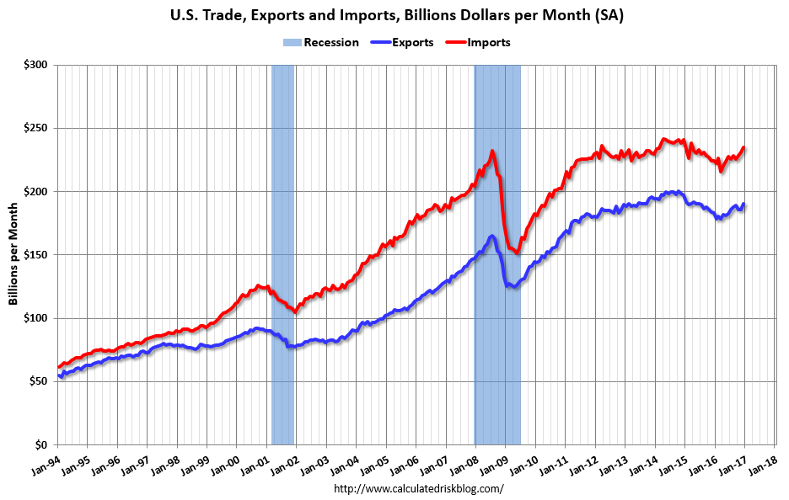
US Trade

Slide 7
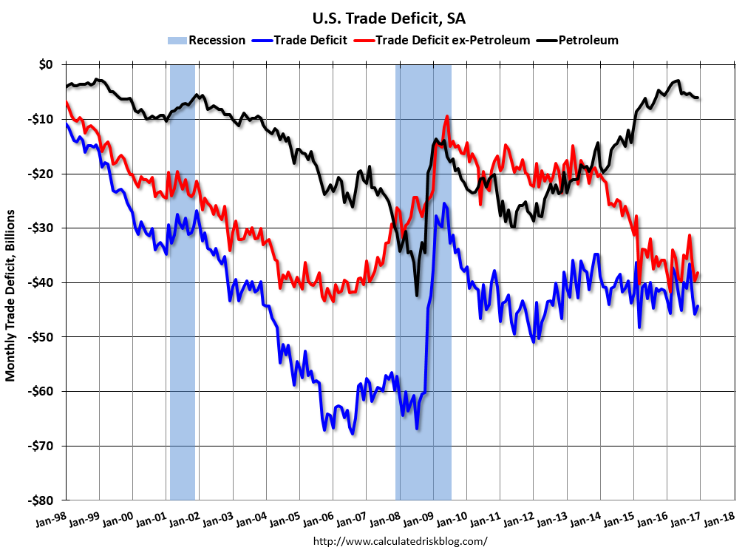
US Trade Deficit

Slide 8
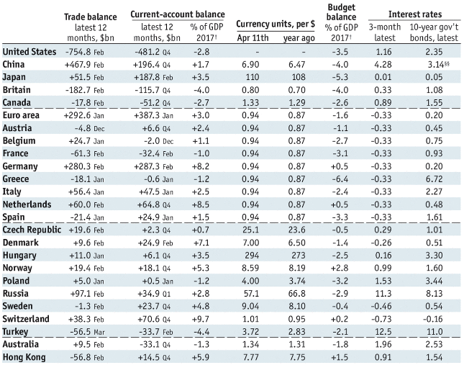
Balance of trade
Trade deficit = exports minus imports
Over the long haul, you can’t buy more than you sell
So, trade deficit means you owe money
This lowers the value of your currency
This makes it harder to buy and easier to sell, ought to tend to equalize over time
Growing economies often run trade deficits
Stable ones often run trade surpluses

Slide 9
Effects of trade deficit
Trade deficit means you are buying more than selling
  Stuff’s cheaper, yay!
  Decreases wages and employment, boo!
How does the US keep getting away with it?
  We have invested a lot overseas, which pays dividends and helps to equalize
  We have reserve currency that keeps dollar stronger
  The rest of the world trust US governance
    They invest here because they consider it to be safer than their country

Slide 10
China: Currency Manipulator?
https://www.nytimes.com/2017/04/11/business/economy/trump-china-currency-manipulation-trade.html?_r=0
Short answer: they used to be, but not so much anymore
  They used to try to make their currency cheaper, now more expensive
https://www.ft.com/content/cbde535e-f3db-11e6-8758-6876151821a6

Slide 11
Exchange Rates
Exchange rate is the price of one currency in terms of another
Strong dollar = cheaper imports, goods
Weak dollar = cheaper exports
“Trump says ‘strong dollar’ may be too strong for its own good”
‘Look, there’s some very good things about a strong dollar, but usually speaking the best thing about it is that it sounds good.’
  http://www.marketwatch.com/story/trump-comes-around-to-the-sound-of-the-phrase-strong-dollar-2017-04-12
  FACT-CHECK: basically, true

Slide 12
Domestic Political Economy of Exchange Rate Policy
There are distributional implications and electoral implications.
International coordination or cooperation may not find sufficient support within a nation, if the losers are sufficiently powerful.
  Groups involved in foreign trade and investment should favor fixed rate systems
  Groups whose economic activity is limited to the domestic economy should favor a floating regime
Politicians may wish to manipulate exchange rate for the purpose of winning elections.
  In single-member plurality systems prefer a floating regime so that they can engineer support before elections
  In proportional systems pegging is more likely because governing parties can time elections to a good economy.

Slide 13
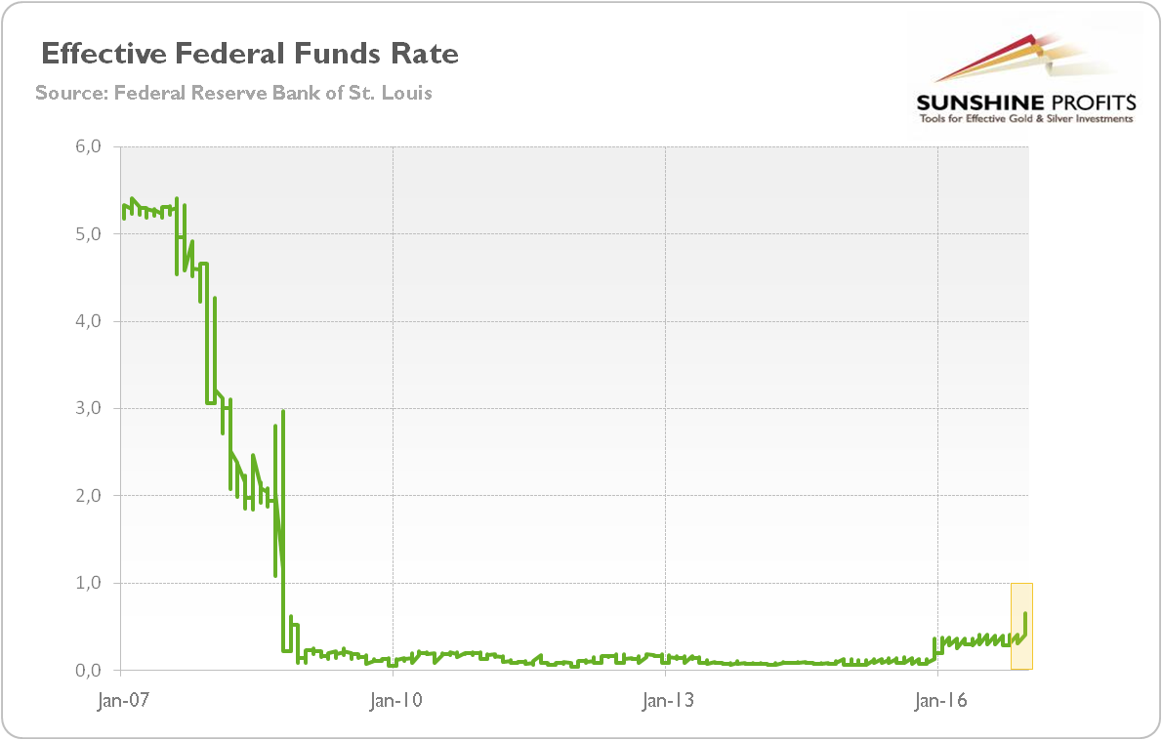
Fed Funds Rate

Slide 14
Exchange Rates
Raise interest rates = stronger dollar = less inflation
  Good for consumers, holders of credits
Lower interest rates = weaker dollar = more inflation
  Good for producers of export goods, holders of debt
In the short term this is controlled by monetary policy of the Gov
  Federal Reserve (Janet Yellen) in the USA
In the long term this is controlled by the output of the economy
  Stronger economy is going to have stronger dollar
    Makes sense, you make more stuff, you sell more stuff, you get to buy more stuff
US lets it’s exchange rate float against the world, China accused of “manipulating”.

Slide 15
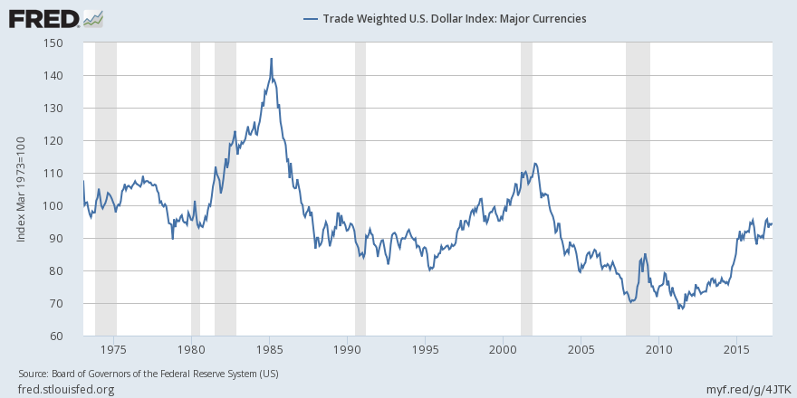
US Exchange Rate

Slide 16
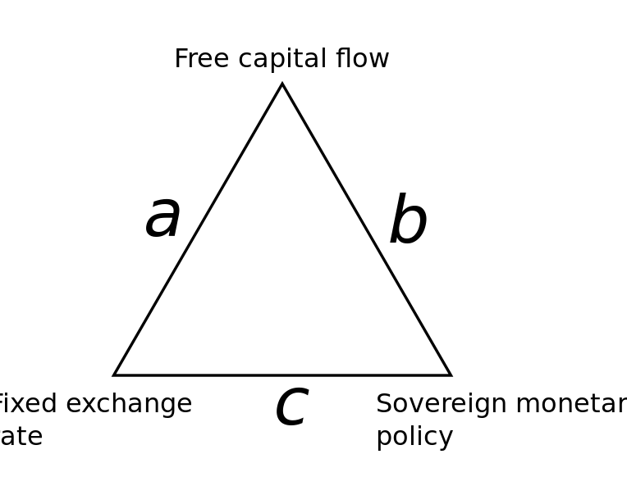
Impossible Trinity
You can have two out of three, but not all three
US has Free capital flow and sovereign monetary policy
Greece has free capital flow and fixed exchange rate
China has (basically) fixed exchange rate and sovereign monetary policy

Slide 17
Advantages of fixed vs. floating regimes
Fixed exchange rates:
  It reduces transaction costs and exchange-rate risk, which can discourage trade and investment. (Frankel/Rose 2002; Meissner 2005)
  It provides a credible anchor for monetary policy.
Floating exchange rates:
  It enables countries to pursue an independent monetary policy, and allows for adjustments when macroeconomic situation changes.

Slide 18
There are a whole slew of options from pure fixed to pure float
In order from less flexible to more:
Currency Union (Euro Zone, Dollarized countries)
Currency Board (Argentina, Hong Kong, some E. Eur.)
A “truly fixed” exchange rate (West and Central Africa)
Adjustable peg (Bretton Woods)
Crawling peg (Chile)
Basket peg
Target zone or band (EMU before 1999)
Managed float
Free float (US is closest example)

Slide 19
Protectionism
Attempt to tilt trade in favor of your industries/sectors by limiting imports
  Helps domestic producers of tradable goods
    Also helps workers whose labor becomes more in demand
  Hurts consumers
    Doesn’t help workers with long term contracts
  Tariffs = taxes on imports
  Quotas = restrictions on imports
  Subsidies = free money to certain industries
  Regulations = rules that limit certain things
    Environmental, safety, health, “fair trade”

Slide 20
Globalization
Globalization is the phenomenon whereby trade, culture, language, and norms are spreading across the globe more and more
  It was once a rare thing to have an item brought home by a traveler from overseas. Now, most things I own are made overseas.
  We eat food from all over the world, talk with people from all over the world, and share media from all over the world
    Is this the start of a new global “nationalism”?

Slide 21
Globalization
Argument for trade/globalization
  Fosters prosperity
    Specialization
    Greater markets
  Creates opportunities for cultural exchange
  Fosters global peace, perhaps?
    Seems to be the case that trade makes war less likely
Also, tied countries into non-Communist camp during Cold War.

Slide 22
Globalization and the Modern World
Globalization is the phenomenon whereby the world is increasingly connected both economically and culturally.
  Goods and bads
    Economic growth
    New cultural opportunities
    Reliance on global system
    Homogenization
    Inequality

Slide 23
Economic Globalization
International Monetary Fund (IMF, founded 1944)
  Expansion of free trade
General Agreement on Tariffs and Trade (GATT, 1947)
  123 member nations
World Trade Organization (WTO), takes over from GATT in 1995)
Global corporations expand, treat globe as single market
  Decentralize as necessary to take maximum advantage of regional markets, labor pools, taxation policies
Implications for exploitation of human and natural resources

Slide 24
Washington Consensus
Reform prescriptions for developing countries in economic crisis
  Fiscal discipline – no/low deficits
  Redirection of public spending towards pro-growth areas
  Tax reform
  Market interest rates
  Competitive exchange rates
  Lower trade barriers
  Lower barriers to FDI (foreign direct investment)
  Privatize state industries
  Deregulation
  Legal support for property rights

Slide 25
Economic Growth in Asia
Japan benefits from Marshall Plan, treaty limitations on defense spending
Massive postwar economic expansion, slowed in 1990s
China integrates elements of market economy, benefits from huge cheap labor pool
But interrelated economies fragile, financial crisis in 1997

Slide 26
Trading Blocs
European Union
  Six nations when formed in 1957
  Maastricht Treaty of 1993: moving toward political integration
Organization of Petroleum Exporting Countries (OPEC)
  Established 1960, dominated by Arab and Muslim countries
  Used economic might to place embargo on US oil, 1973-1975
Association of Southeast Asian Nations (ASEAN)
North American Free Trade Agreement (NAFTA)

Slide 27
Consumption and Cultural Interaction
“Americanization” or “McDonaldization”
  American culture exported
Yet cultural borrowings from non-American societies
English language becomes predominant
  Influence of British colonialism, America, the Internet

Slide 28
Jihad vs. McWorld
Title from an article and book by political theorist Benjamin Barber. Reflects his argument that future conflict will be between the forces of globalism and tribalism.
  Barber argues that globalism is primarily the spread of traditionally Western (American) values of democracy, capitalism, consumerism, etc… and as globalism, or “McWorld”, reaches deeper and deeper into more places it sparks a reaction against it with the intent of stopping the erosion of local values.

Slide 29

Jihad vs. McWorld
Short clip on Sayyid Qutb in Greeley, CO from “The Power of Nightmares”

Slide 30
International Liberalism
We return now to the beginning of our course, our discussion of liberalism and liberal values.
  Reactions against globalism are often reactions against “liberal values” that place individual self-interest and the rights of individual self-expression above others threatening to erode traditional values.
How do we secure prosperity and find meaning in the modern world?

Slide 31
Videos on Globalization
“Commanding Heights”
“Life and Debt”
“The Power of Nightmares”
Good documentaries if you want to know more.

