Slide 1
Lecture #9 - More on Globalization
April 27, 2017

Slide 2
Does Globalization aid the poor or the rich?
Those who support globalization argue that the biggest winners are poor workers in poor countries
  Cheap labor gets to substitute for more expensive labor in first world
  First world investment brings needed capital to poor countries
  Poor countries grow more quickly, workers have jobs and rising wages
Critics of globalization argue it puts more power in the hands of the wealthy and powerful
  By reducing barriers to capital, it gives capital more power and control.

Slide 3
Washington Consensus – the model for development
Fiscal policy discipline, with avoidance of large fiscal deficits relative to GDP;
Redirection of public spending from subsidies ("especially indiscriminate subsidies") toward broad-based provision of key pro-growth, pro-poor services like primary education, primary health care and infrastructure investment;
Tax reform, broadening the tax base and adopting moderate marginal tax rates;
Interest rates that are market determined and positive (but moderate) in real terms;
Competitive exchange rates;
Trade liberalization: liberalization of imports, with particular emphasis on elimination of quantitative restrictions (licensing, etc.); any trade protection to be provided by low and relatively uniform tariffs;
Liberalization of inward foreign direct investment;
Privatization of state enterprises;
Deregulation: abolition of regulations that impede market entry or restrict competition, except for those justified on safety, environmental and consumer protection grounds, and prudential oversight of financial institutions;
Legal security for property rights.

Slide 4
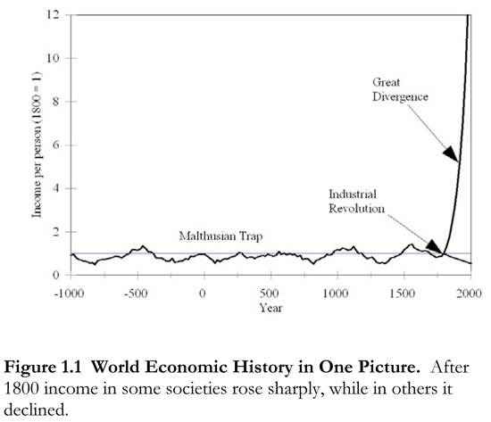
Historical Roots of Inequality
Great Divergence – rooted in the industrial revolution
In 1800 per capita incomes were roughly equal in Europe and Asia
By 1900 per capita incomes were about ten times higher.
European wealth led to European domination of the world

Slide 5
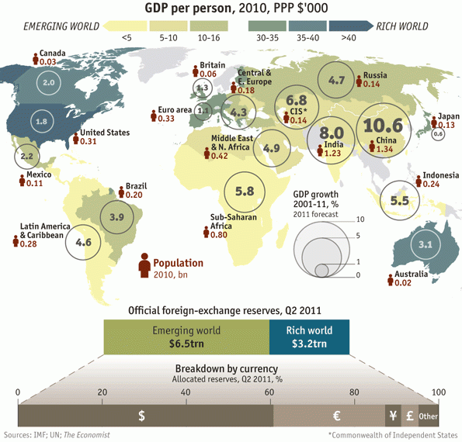
The great convergence
Growth rates have generally been much higher in the parts of the world that are much poorer
Is globalization a tool for bringing up incomes in the rest of the world? Or a tool for continued Western dominance?

Slide 6
Poverty and inequality
Does globalization help poverty and lower inequality, or the opposite?
It’s complicated…you knew it would be right?
  Measured poverty does seem to be way down over the last 30 years, especially in Asia (India, China, SE Asia)
  But displacement and new economy can make measured effects less than accurate
    If you live in a settled village as a subsistence farmer, your wages may be quite low, but you feel more satisfied than in an urban slum

Slide 7
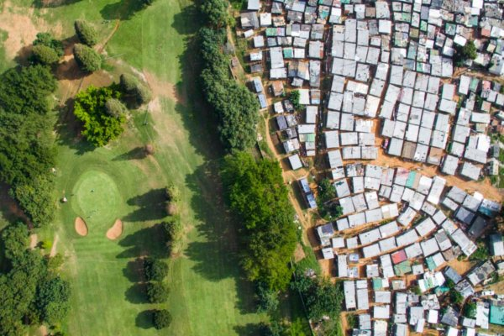
Rich and poor

Slide 8
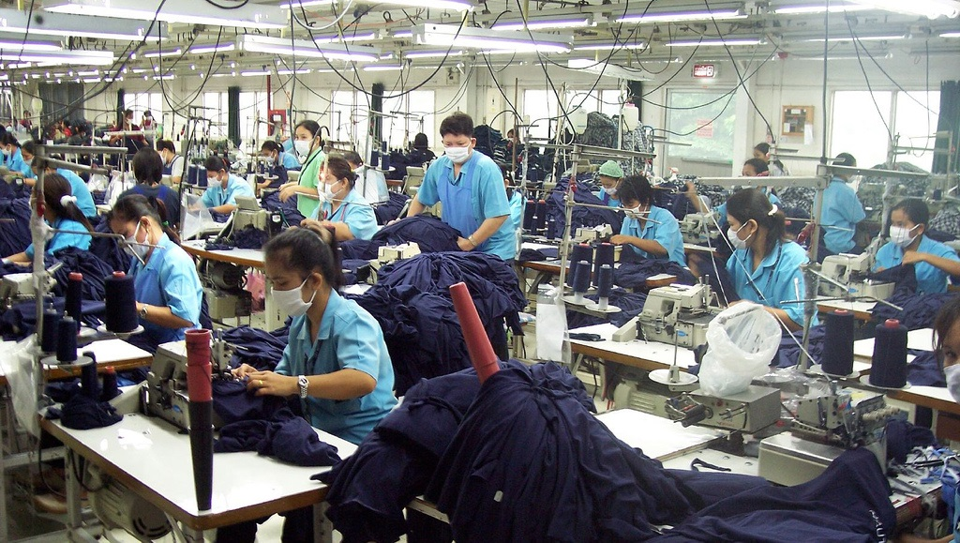
Sweatshops
Modern day slavery?
Or path to riches?
Provides jobs, but not exactly great conditions or high wages by our standards

Slide 9
Globalization and Government
Capital acquires power over government
  You have to live as capital wants to attract and keep capital
  Creates regulatory competition
    Race to the bottom
Governments in smaller (usually poorer) countries lose ability to govern capital and maintain independent policy regimes.
  “humiliation” “feeling of weakness” “displacement” “insecurity”
“Life and Debt” https://vimeo.com/149178039

Slide 10
Problems of “late-development”
You have to compete against established economies
  “first-mover advantages”
Economics of scale – buying in bulk is cheaper
Network effects – silicon valley, Hollywood, for example
Investment funds – helps to be close to capital

Slide 11
Strategies for dealing with late-development
Protectionism
  Protect nascent industries to allow them time to develop
  Pursued by both Germany and the USA
    Alexander Hamilton pushed in “Report on Manufactures”
Downside
  Encourages “crony” capitalism, corruption
  Encourages inefficiency
  Seems not to work
Most common model today, export-led growth, structural adjustment
  i.e. cheap labor, “sweat-shops”
  Creates higher wages, capital investment, then move up the value chain over time

Slide 12
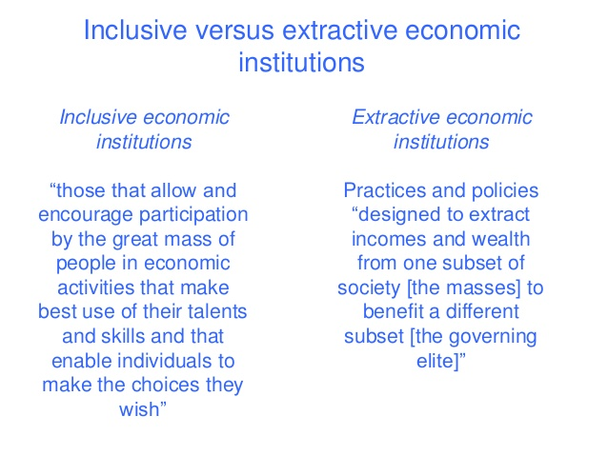
Rule of law
Good governance also seems to be a key component of long-term
  Inclusive vs. extractive institutions

Slide 13
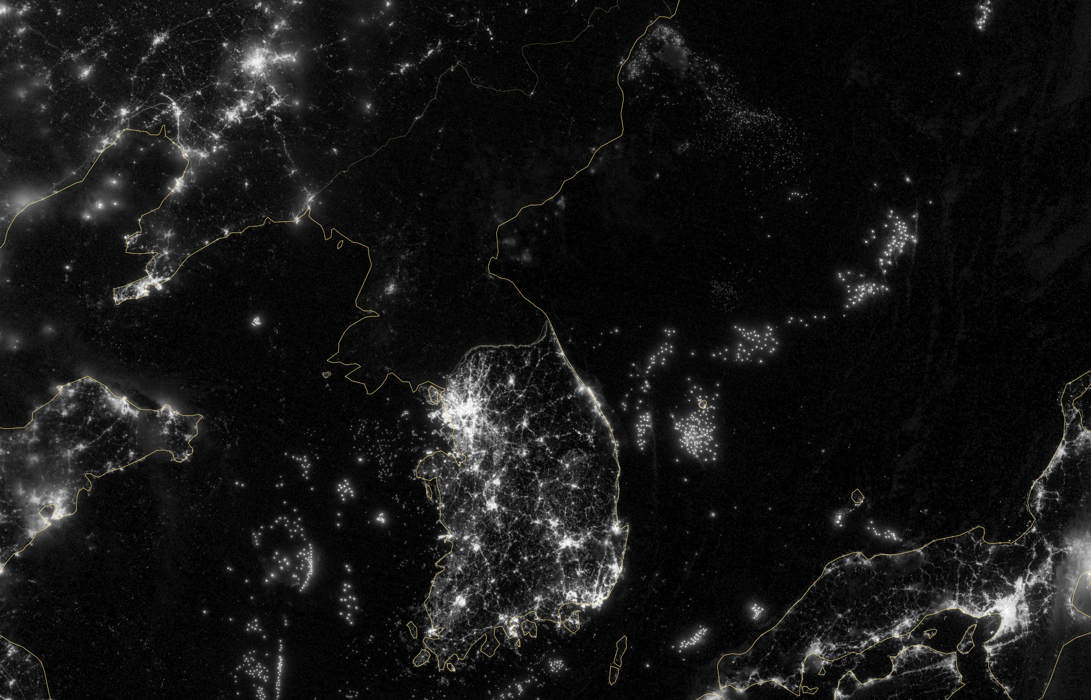
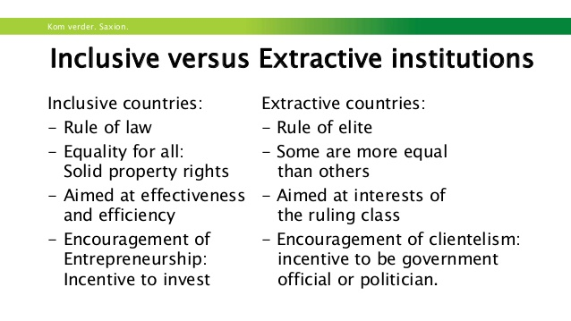
Institutions Matter

Slide 14
Societies that are “inclusive”
Inclusive political and economic institutions create chance for long-term growth
  Allows for innovation, investment, payoffs to education, progress
  “winners” can become “losers” and “losers” can become “winners”
    Amazon vs. Sears
Extractive political and economic institutions encourage “rent-seeking”
  Rent-seeking is looking to get a payoff not from innovation but from your position in the system
  Winners use their power to stay “winners”, keep status quo

Slide 15
Inequality tends towards extraction
As inequality grows higher, the payoff to winning becomes greater
  Incentive to try to be one of the few winners intensifies, status quo becomes more rigid, economy and politics suffers
Reasons to be skeptical of long-term future success in China if it fails to politically liberalize.

Slide 16
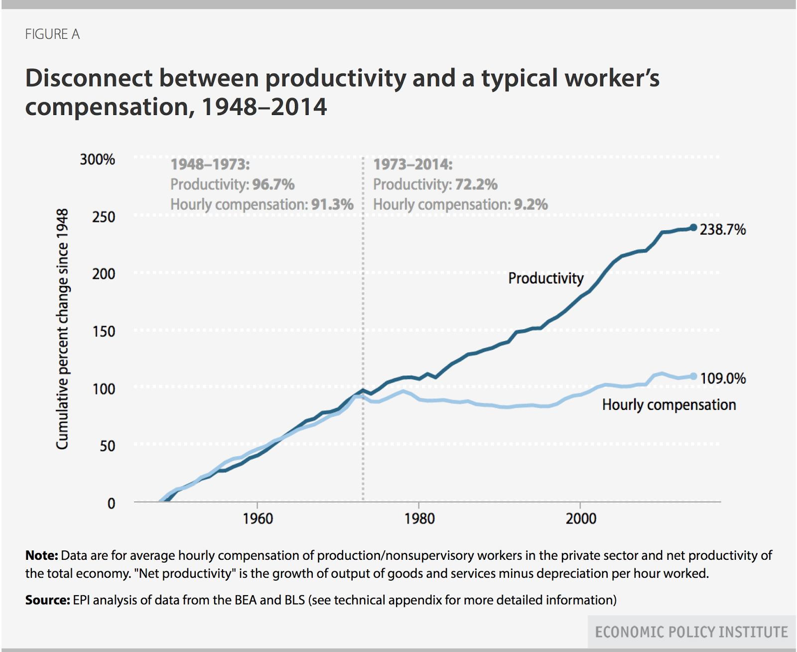
Problems in the First World

Slide 17
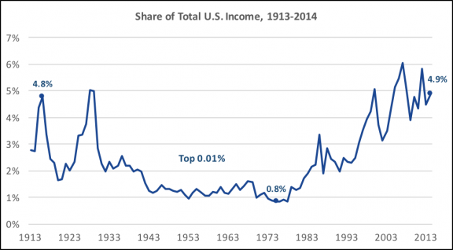
Inequality in the USA

Slide 18
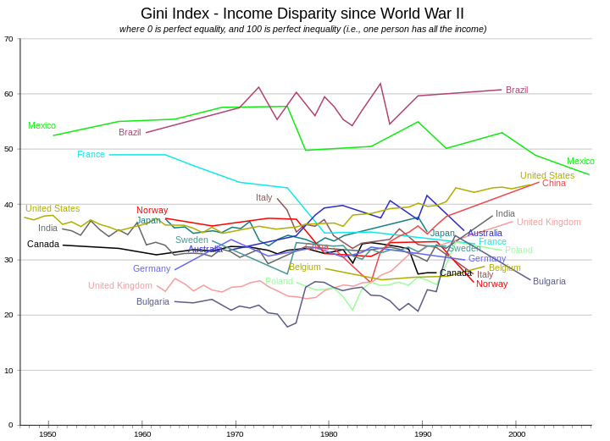
Gini Index – measure of inequality

Slide 19
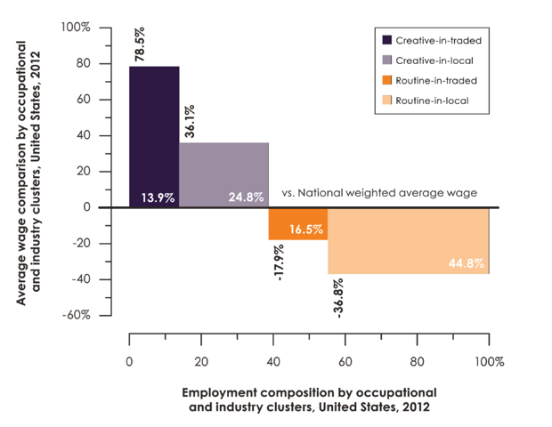
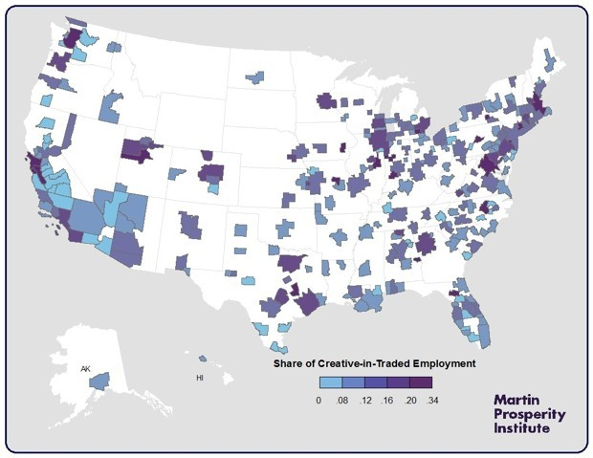
Some places doing better than others

Slide 20
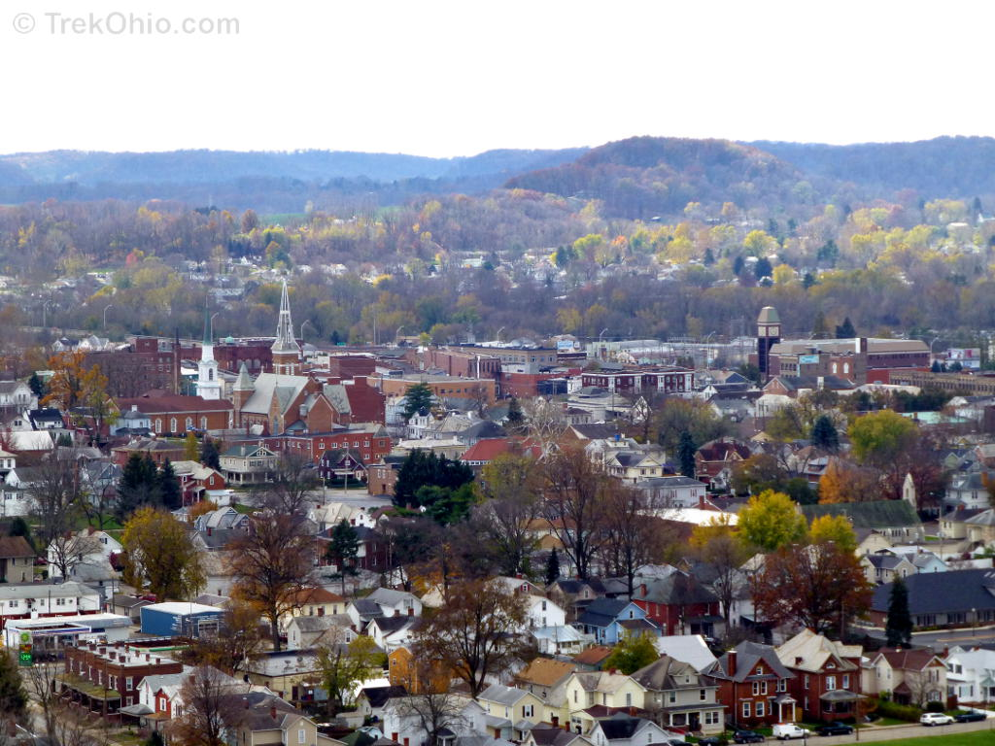

Middle America

Slide 21
International Liberalism
We return now to the beginning of our course, our discussion of liberalism and liberal values.
  Reactions against globalism are often reactions against “liberal values” that place individual self-interest and the rights of individual self-expression above others threatening to erode traditional values.
  But also fears of an atomizing, materialistic, “selfish” culture.
    Loss of community, loss of control, illusion of freedom, triumph of base desires.
We return to a theme of our course. How do we secure prosperity and find meaning in the modern world?
  Liberalism has been accused of eroding meaning and fulfilling community for the sake of prosperity
    How do you react to the question, what are you going to do after college?

Slide 22
Environmental Impact
Biodiversity under threat: 4500 animal species threatened
Global warming
  Greenhouse gases
  Kyoto accords, 1997
Human mortality rate declines steadily, several regions work on birth control measures
“Tragedy of the Commons”

Slide 23
Why Global Warming will be so difficult to stop
C02 emissions linked to prosperity
Costs are borne now, benefits come later
Problem is worldwide w/ no one culprit and no one victim
  Tragedy of the commons
  Prisoner’s dilemma
    Rational self-interest leading to suboptimal outcomes
      Externalities
      population

Slide 24
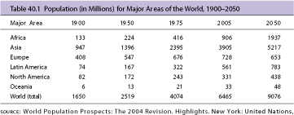
Population for Areas of the World, 1900 – 2050

Slide 25
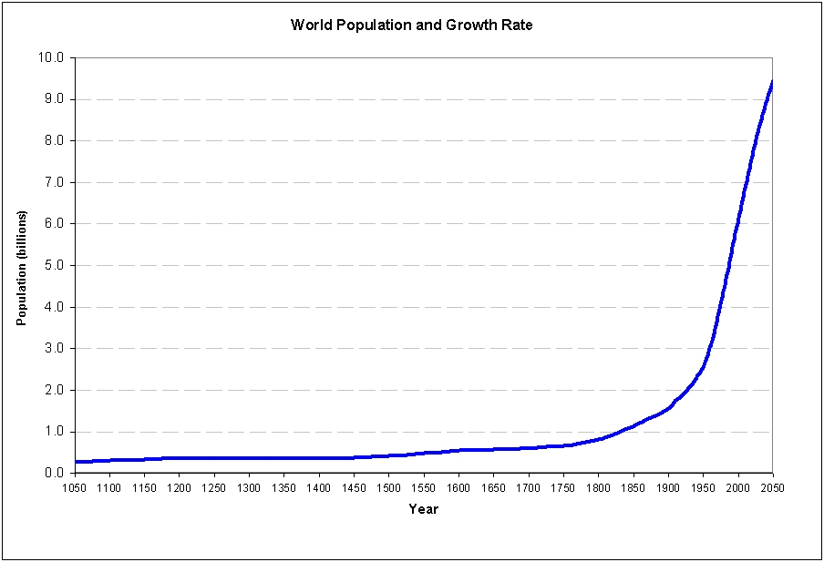

Slide 26
Global Diseases
Disease has always played an important role in the development of human communities
1978 UN called for end to all infectious diseases by 2000 – unrealistic goal
Ancient diseases TB and malaria on the rise
New diseases Ebola and AIDS
Threat throughout the world but has struck the developing world the hardest

